Slide 1

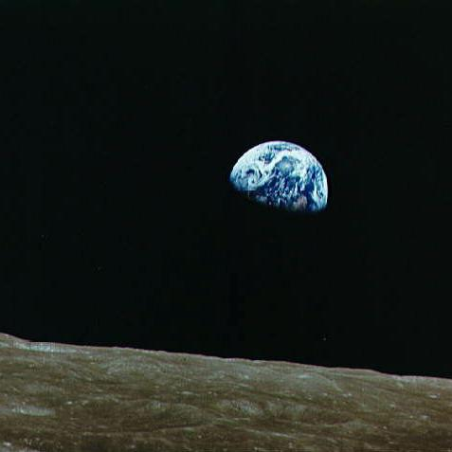
Techtok
All About Space
July 30, 2021
Soguilon, Marx

Slide 2

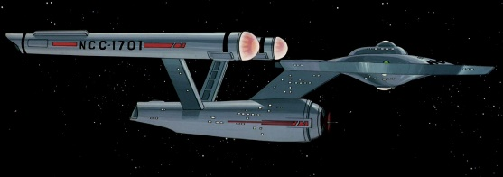
Intro
Space: the final frontier
Notes:
The quick brown fox jumps over the lazy dog

Slide 3
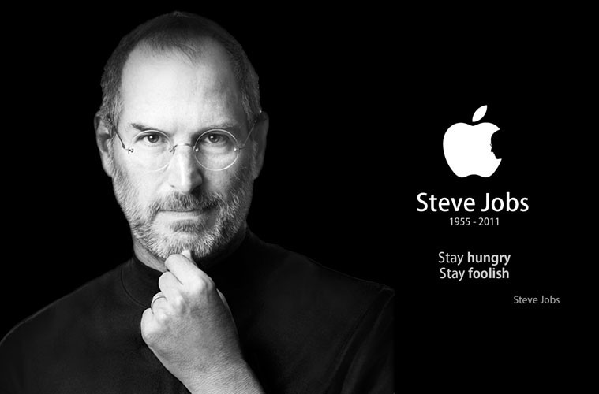
“You cannot understand what is happening today without understanding what came before.”
Steve Jobs

Slide 4
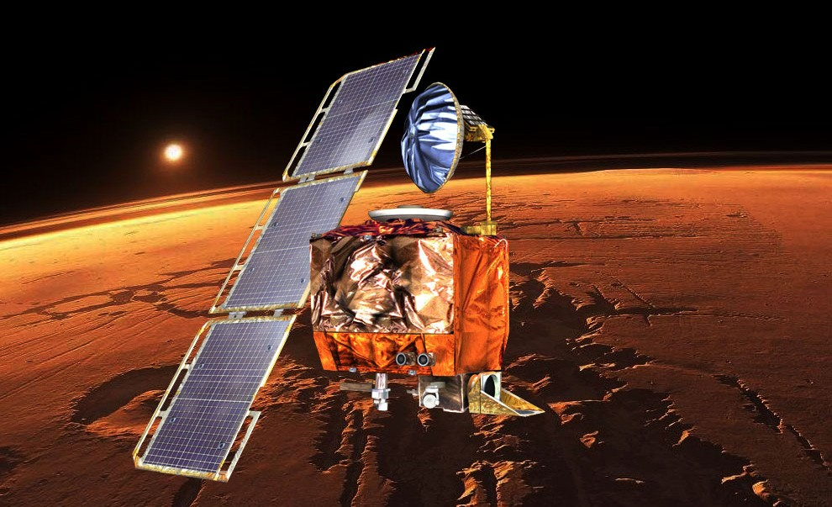
Know your requirements
NASA: The Mars Climate Orbiter
The orbiter’s mission was to reach Mars orbit to study the weather and climate and to ultimately, serve as a communications relay for the lander. The orbiter, launched on December 11, 1998, never made it into orbitdue to a software bug in a ground based system. When attempting enter Mars orbit on September 23, 1999, the orbiter approached at a lower than expected altitude, causing it to disintegrate.

Slide 5
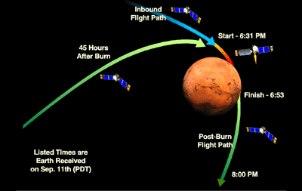
Know your requirements
NASA: The Mars Climate Orbiter
The cause was ultimately determined to be that the ground based software generated and sent thrust instructions using English measurements (pound-force <lbf>), while the onboard software was expecting the measurements in metric (Newtons <N>).

Slide 6
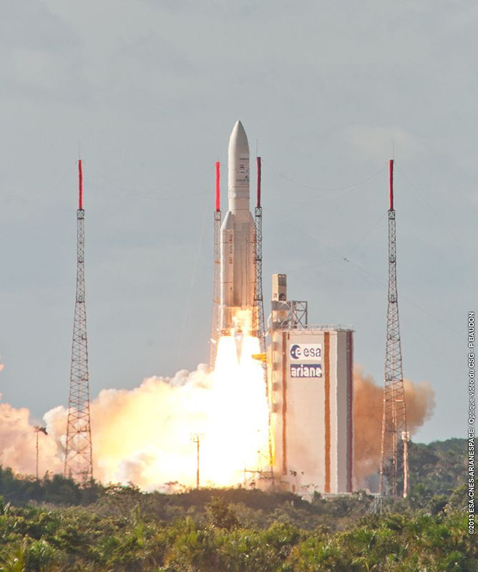
Understand your datatypes
European Space Agency (ESA): Ariane 5 Cluster
Cluster was a constellation of four European Space Agency spacecraft which were launched on the maiden flight of the Ariane 5 rocket, Flight 501, and subsequently lost when that rocket failed to achieve orbit. The launch, which took place on Tuesday, 4 June 1996, ended in failure due to multiple errors in the software design. The guidance system (and its backup, which had the same bug) shut down, causing the rocket to veer off course and, ultimately, self destruct 30 seconds after launch.

Slide 7
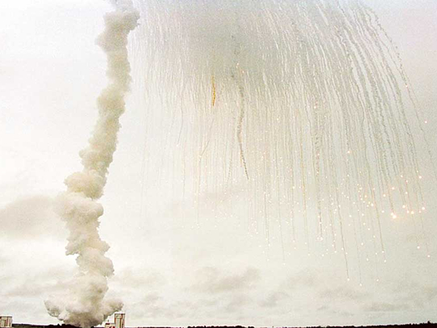
Understand your datatypes
European Space Agency (ESA): Ariane 5 Cluster
The guidance software tried to convert the horizontal velocity (which was greater than anticipated) from a 64-bit floating point number to a 16-bit signed integer, which caused an overflow error.

Slide 8
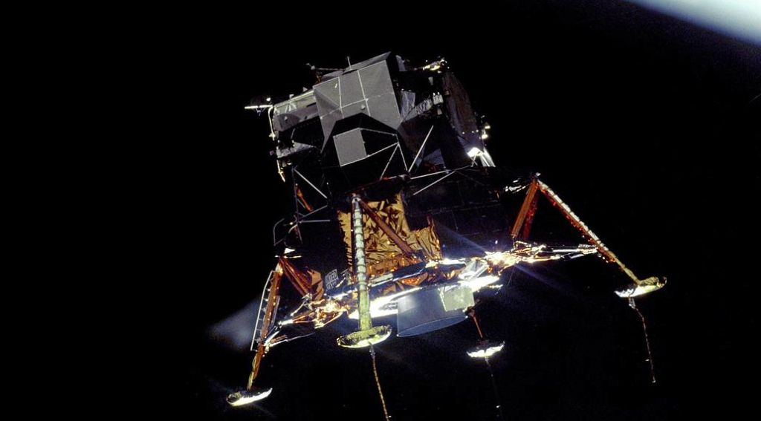
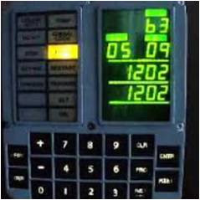
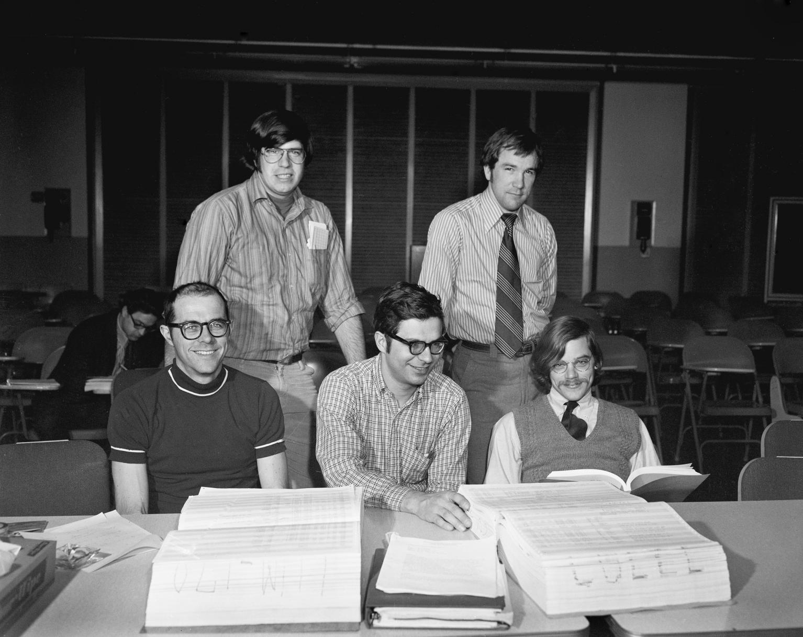
Memory overload
NASA: Apollo 11 Moon Landing
Who would forget the date July 24th 1969 as the Apollo 11 mission touched down the moon. But before landing, little did we know that there is what they call the 1201 and 1202 error that could have aborted the mission. As the Eagle (Lunar Excursion Module) began its final descent to the lunar surface and the Apollo Guidance Computer became overloaded.
The programmer of the landing program Don Eyles (23yrs old)
..and these guys here needs to code review this as a book! pun
The computer. Yes.
Thank you.
..but you have given me 36KB of memory only @#$5^!

Slide 9
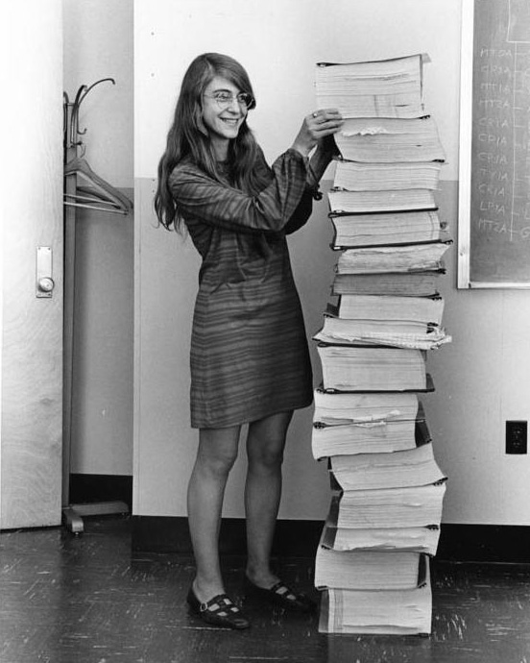
Memory overload
NASA: Apollo 11 Landing
The cause of the overload was due to an astronaut guideline to set the Rendezvous Radar Switch to AUTO that was meant for ascent. So the countermeasure was to set this to MANUAL and reboot the computer. What’s good about the computer that was used that time is that when you do a reboot it will continue where it left.
GIRL
POWAA!!!
Margaret Hamilton. Onboard flight software developer
All the codes for the Apollo Program

Slide 10
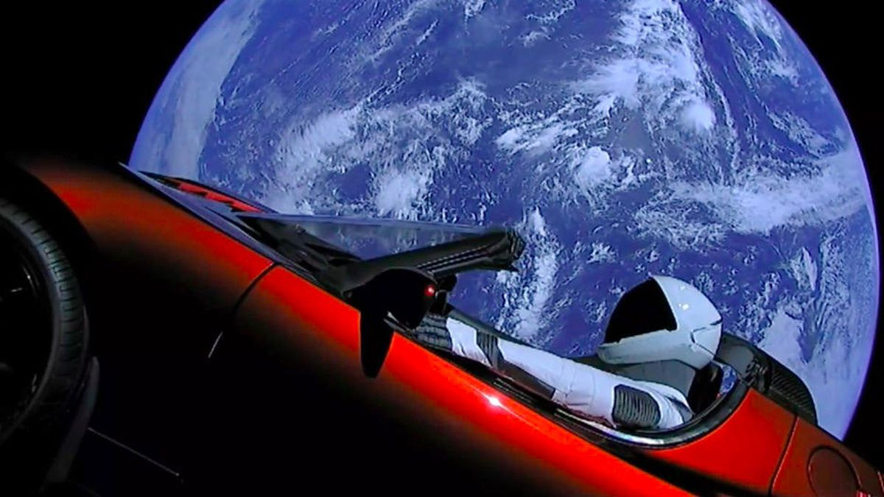
Fail fast, Fix fast
SpaceX: Falcon Series
The most awesome company ever!!! On December 15th 2015 SpaceX pulled off history's first-ever first stage rocket booster landing during an orbital launch. Only after over a year of failing fast and fixing fast.

Slide 11

Fail fast, Fix fast

Slide 12
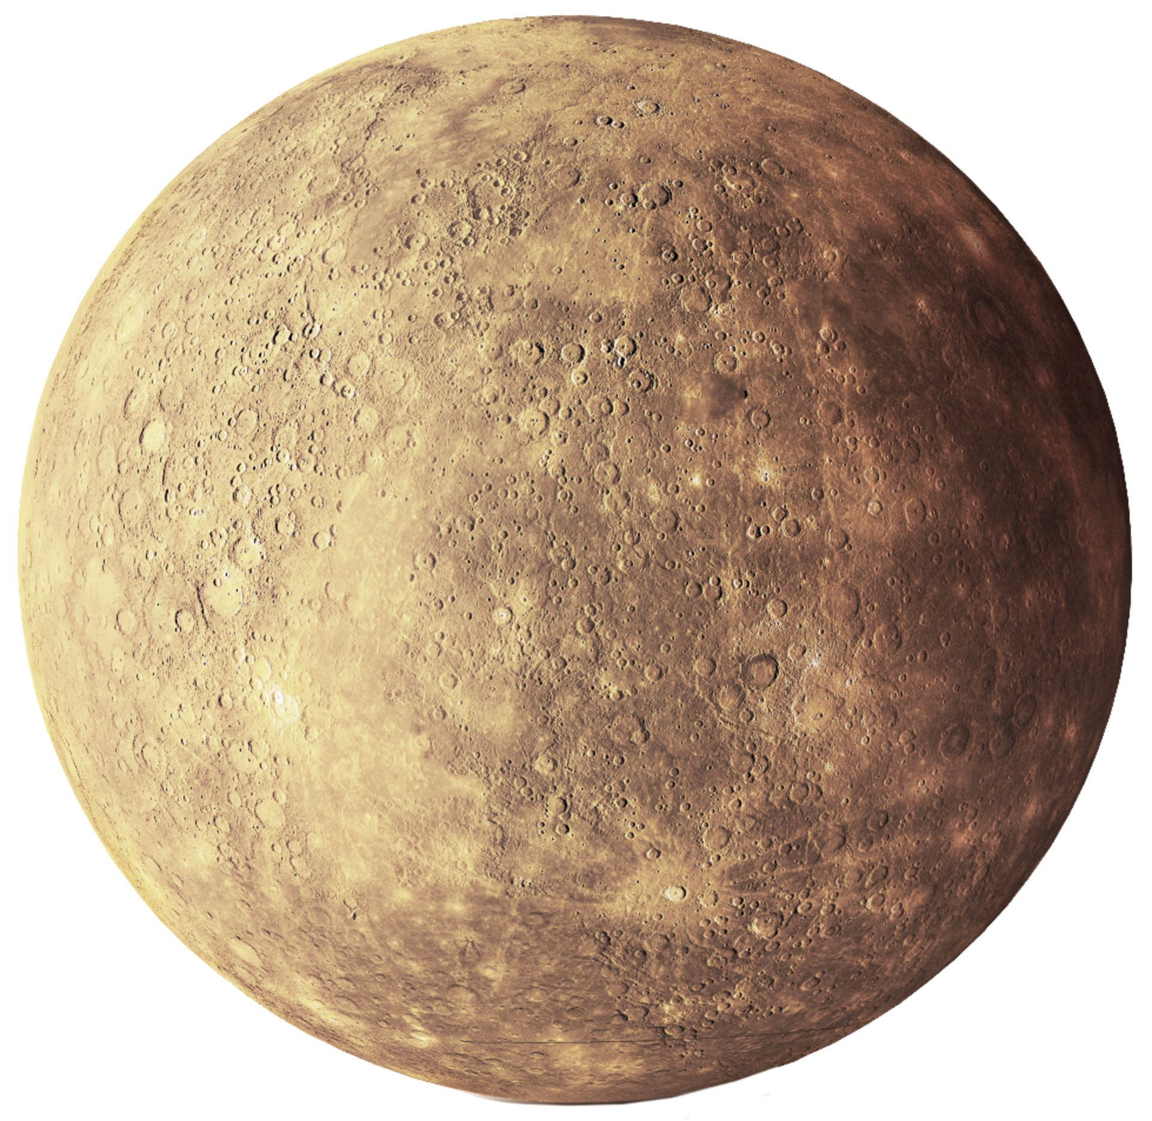
MESSENGER spacecraft

Slide 13
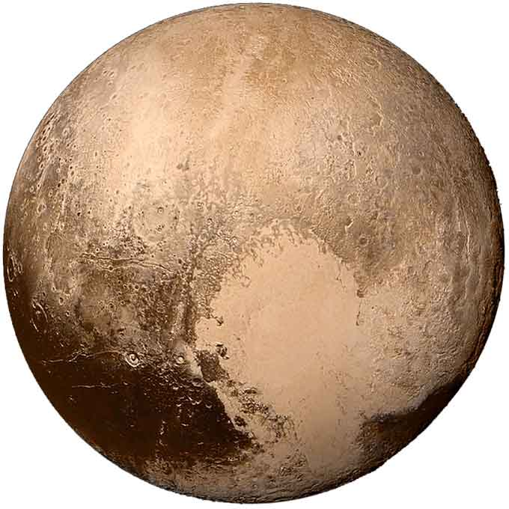
New Horizon

Slide 14
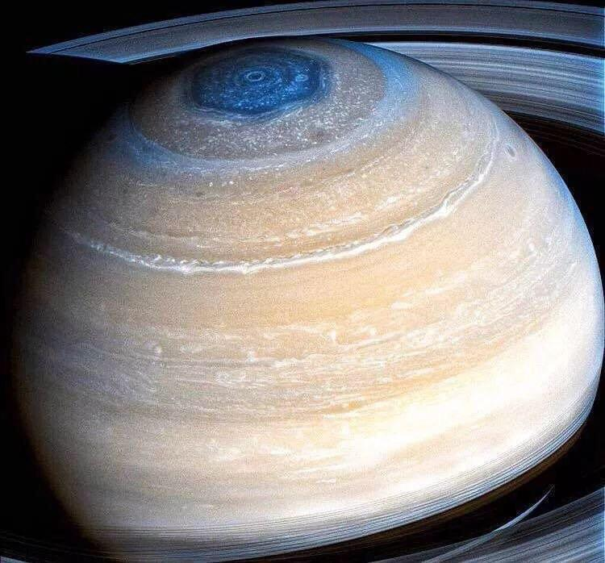
Cassini Spacecraft

Slide 15
Outro
Being a programmer is hard.
Right now, you may be bored with what you are writing, may be too relax with what you are coding, and may be too exhausted with what you are testing…
Always keep in mind that your role in Fujitsu is meaningful and is highly depended by others.
It might not be too fancy now but the things you do here will teach you the skills, values, and mentality on what you can do in the FUTURE.

Slide 16
